Slide 1
You wanted More MARTA. Now it’s here!
COMMUNITY MEETING – SOUTHEAST
Ehren Bingaman, More MARTA Atlanta | Nov. 27, 2018
Notes:
Over the past two years, we have engaged with thousands of residents from across the city of Atlanta. Through face-to-face interactions, email, phone calls and online and print surveys, the people spoke. And they spoke passionately.
They want transit – transit that connects our communities; improves first and last-mile connectivity; expands access to jobs; enhances mobility options for seniors and individuals with disabilities; and improves the overall quality of life for residents in the city – and beyond.
In essence, they want More MARTA, literally. And over the next 40 years, that’s what we’ll be delivering.

Slide 2
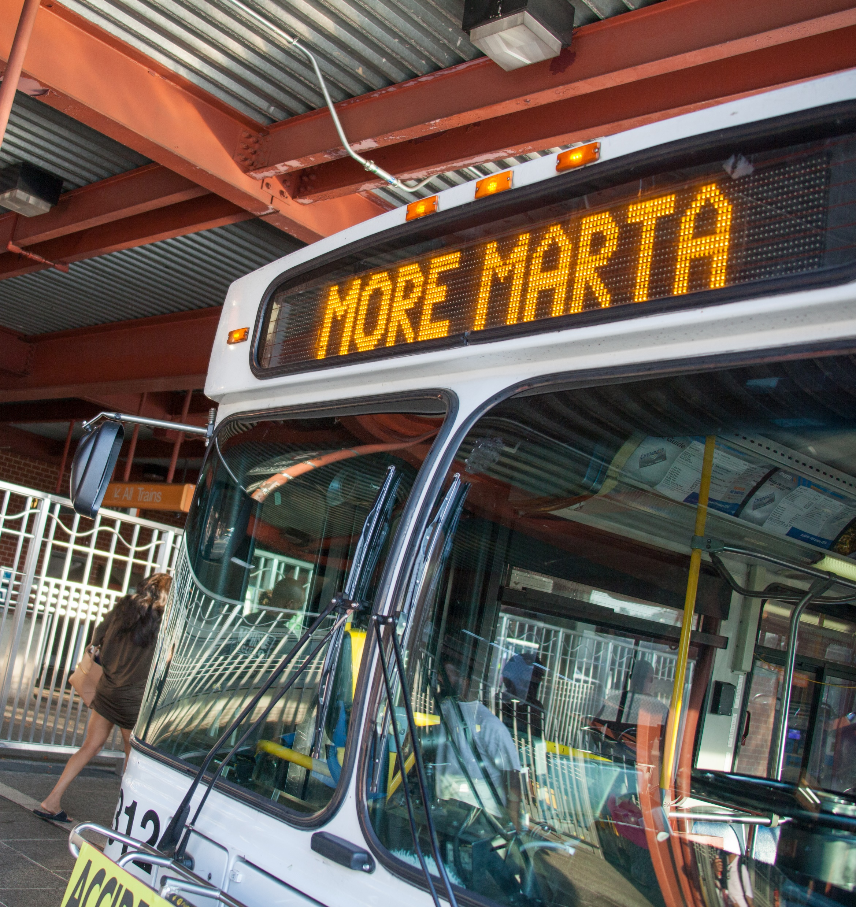
Today’s agenda
About More MARTA Atlanta
Timeline/historic vote
Program highlights
Transit modes
Project maps
Project benefits
Project durations
Region-wide transit expansion initiatives
Major system upgrades
Next steps on More MARTA Atlanta
Stay connected
Notes:
Today, we’ll provide you an overview of the More MARTA Atlanta program. We’ll offer highlights, discuss the various transit modes, show maps of the transit modes and talk about program benefits.
We’ll also give you some insight on what’s to come in the weeks, months and years to come.
And while the focus today is on More MARTA Atlanta, we have a number of exciting systemwide initiatives underway that we want to share toward the end of the presentation.

Slide 3
MORE MARTA ATLANTA: A QUICK SUMMARY
What is it?
What will it do?
How will it be funded?
$2.7 billion investment in transit expansion and upgrades over four decades
A partnership between MARTA and City of Atlanta
Expands accessibility, connectivity and mobility
Supports population growth
Aligns with City of Atlanta’s vision for growth
Paid for by a half-penny sales tax passed in 2016
Federal and private funds will be sought to advance and expand key projects
Notes:
So here’s a quick summary of the More MARTA Atlanta program:
What is it?
It’s a $2.7 billion investment in transit.
It represents the first significant transit investment in more than 40 years.
It’s also a partnership between MARTA and the City of Atlanta.
What will it do?
The program expands and enhances services throughout the City of Atlanta, from Campbellton Road to the BeltLine to the Clifton corridor.
The program includes investments in a variety of new, exciting modes of transportation, which I’ll explain later.
Equally important, the program helps address the transportation needs of growing, evolving population.
How will it be funded?
It’s paid for by half-penny sales tax overwhelmingly passed by voters in 2016.
It’s important to note that not all of the projects are fully funded through the sales tax. But that doesn’t mean a project won’t get additional funding over the next 40 years through federal and regional support, public-private partnerships and other sources.

Slide 4
MORE MARTA ATLANTA: A BRIEF History
2016
2017
2018
Compiled plans
Conducted public outreach
Developed project list and guiding principles
Tax vote and approval
Partnership formed between MARTA and City of Atlanta
Public engagement and technical evaluation conducted
Proposed project list identified
Ongoing public engagement conducted
Project list approved by MARTA Board of Directors on Oct. 4
Notes:
Here’s a quick history:
From the beginning, the More MARTA Atlanta program has been shaped by public input.
Before the 2016 referendum vote, MARTA was putting plans together, analyzing data and engaging with the community to develop a set of guiding principles and a comprehensive project list. This first list had 70-plus projects and totaled approximately $11.5 billion.
After the More MARTA referendum vote passed in November 2016, a partnership was created between MARTA and the City of Atlanta to move transit expansion forward.
The sales tax, projected to bring in approximately $2.7 billion until 2057, meant the initial list needed to be pared down to fit within that budget. To achieve this, MARTA conducted further technical review AND public input.
This effort led to the introduction of a list of 17 proposed projects in 2018. After months of additional public input, the MARTA Board of Directors approved a list of 16 projects on Oct. 4, 2018.
Two years of comprehensive planning and outreach
Cross-section of Atlanta engaged over two-year period
40 outreach events and 4,300 surveys collected between May and September 2017
Latest outreach in summer 2018 yielded 7,000+ completed surveys

Slide 5
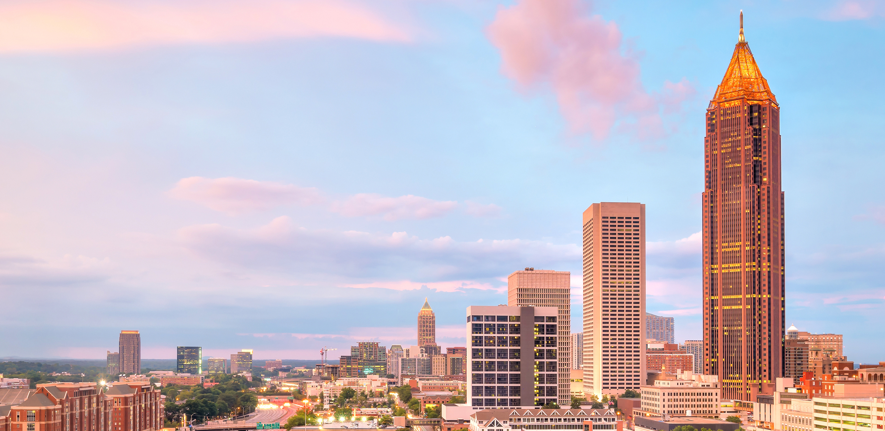
Historic vote: oct. 4, 2018
MARTA Board of Directors’ unanimous vote based on:
Public input
Technical data
Performance measures
Program to be implemented over four decades
Some services already in effect
List of projects refined after months of public input
Program offers room for flexibility
Notes:
On. Oct. 4, MARTA’s Board of Directors unanimously approved the More MARTA Atlanta program. As I said earlier, it represents the region’s largest transit investment in more than four decades.
More than just a list of projects, this investment will produce a layered, integrated transportation network with a renewed focus on customer service and the City of Atlanta’s Community Development goals.
Some new and improved bus services are already in effect, which I’ll talk about later.
While it is important to recognize that this program is an important milestone in Atlanta’s history, it is not the finish line. There is an incredible appetite for more transit in and around Atlanta.
This program will go a long way toward addressing the pent-up demand, particularly for the core of the system, but there are other quality transit projects that will require additional funding in the years to come.
Some of the targeted investments include the following:
22 Miles - Light Rail Transit (LRT)
14 Miles - Bus Rapid Transit (BRT)
26 Miles - Arterial Rapid Transit (ART)
2 New Transit Centers
Additional Fixed-Route Bus Service
Upgrades to existing Rail Stations

Slide 6
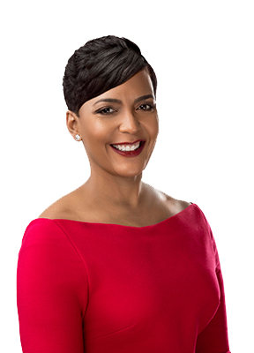
HISTORIC VOTE: REACTIONS
From the public:
From Atlanta’s mayor:
“Excited to see public transit expansion via light rail!!!”
“With development plans spanning from Greenbriar in Southwest Atlanta to Emory University, today’s MARTA vote helps move us closer towards becoming One Atlanta.”
Keisha Lance Bottoms
“MARTA is on the move! I support any and all efforts to make commuting and moving about Atlanta easier.”
“I’m looking forward to seeing these projects succeed and then kicking off the next wave of improvements.”
Notes:
The More MARTA Atlanta program received wide-ranging support leading up to and after the Oct. 4 vote. City, community, business and academic leaders came forward to offer words of praise and encouragement. Equally important, a number of citizens shared their support and enthusiasm.
What other leaders said about the vote
“In Atlanta in the 21st century, transit is the lifeblood of opportunity. It is how millions of Atlantans access jobs, school, health care, and move throughout their communities. Today, we together took an important step in building the Atlanta we want for decades to come.”
– Board chairman Robert L. Ashe
“Think of this as a major and transformational down payment on our future commitment to the city and to the region. This is an important milestone, but it’s not the finish line.”
– MARTA General Manager & CEO Jeff Parker
“The people of Atlanta made it clear that they wanted transit that served more of Atlanta. They made it clear they wanted someone to listen to their concerns about equity and affordable housing. They made it clear that they believed in the original promise of the BeltLine as a project that links Atlanta together, not just a ‘glorified sidewalk.’ Today, MARTA and Mayor Keisha Lance Bottoms showed they heard those voices, and we’re grateful.”
– Cathy Woolard, Leader of BeltLine Rail Now!
“Ensuring that access and dependability for longtime and future MARTA riders is key to my vision of bringing balanced growth and equity to the City. Plan elements such as station enhancements, Campbellton Road and BeltLine transit will be a huge step forward in improving how Atlantans get to work, school, doctors and recreation.”
– Andre Dickens, Atlanta City Council, Post 3 At-Large; Transportation Committee Chairman

Slide 7
TRANSIT MODES: something for every rider
22 miles of
14 miles of
26 miles of
Light rail transit (LRT)
Bus rapid transit (BRT)
Arterial rapid transit (ART)
Typically an electric railway with smaller capacity than heavy rail
Fixed-route service with dedicated bus lanes and traffic signal priority
Fast, frequent transit routes on existing roads and high-density corridors
Notes:
Under More MARTA Atlanta, we hope to reshape how people commute to their destinations, from work to school. Under the program, we are introducing several new transit modes. They are:
Light Rail Transit
LRT is typically an electric railway (like a trolley or streetcar) with a smaller capacity than heavy rail trains. It is characterized by rail cars operating singly (or in short trains) on fixed rails on city streets, similar to the Atlanta Streetcar.
Bus Rapid Transit
BRT is a fixed-route bus mode characterized by dedicated bus lanes, defined stations, and traffic signal priority. These features help buses bypass congestion and make bus travel more efficient throughout Atlanta.
Arterial Rapid Transit
ART is envisioned as a network of fast and frequent enhanced bus transit routes on existing high-density corridors serving “transit lifestyle” market areas. It is characterized by short wait times between buses, traffic signal priority, queue jumps, and enhanced stops.

Slide 8
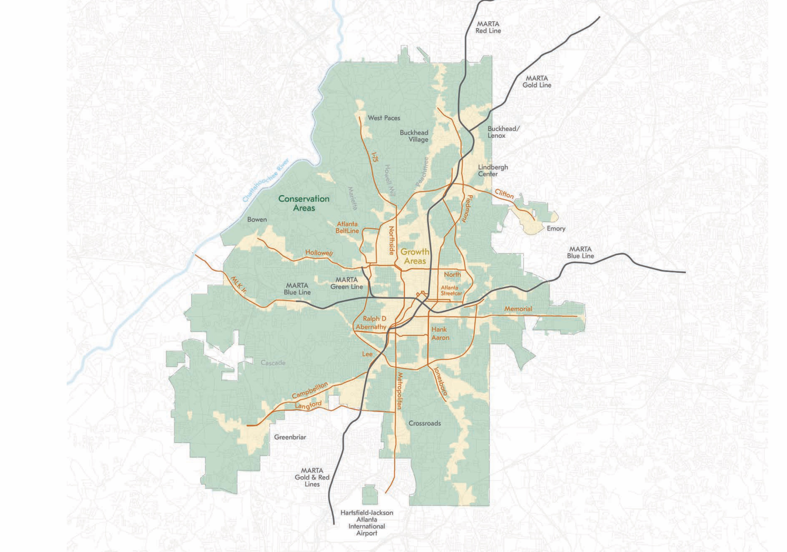
CITY DESIGN
COMPLETE SYSTEM
Notes:
Forty years ago, had we not invested in transit, the region would look dramatically different in terms of density, economic growth and quality of life.
MARTA’s current system amounts to a roughly $6 billion infrastructure investment that continues to pay dividends.
There’s a fundamental link between transit and the densification we’re experiencing in key areas of metro Atlanta. These key areas include Downtown, Midtown and Buckhead. These are areas of growth, and they are in lockstep with MARTA’s rail system.
The More MARTA Atlanta program aligns with the Atlanta City Design, a blueprint for the future that will help Atlanta remain a global center for business, continue to draw the best and brightest talent, and secure Atlanta’s status as a center for culture and innovation.
In essence, the Atlanta City Design project will outline what Atlanta should look like decades from now, as well as guide future decisions on the growth and development of the city.

Slide 9
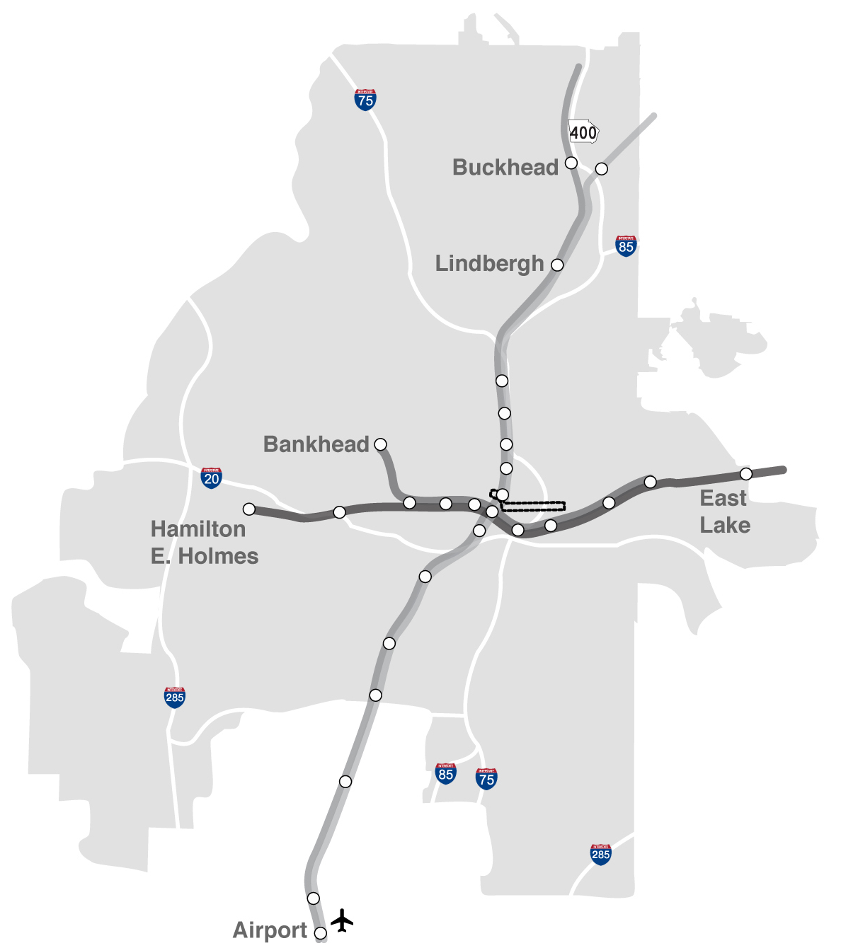
CURRENT RAIL SYSTEM
Notes:
Before I walk you through the More MARTA Atlanta maps, I’d like to take a moment to discuss MARTA’s current rail system.
Formed in 1971 as a bus-only system, MARTA is now the ninth largest transit system in the United States. It has 38 rail stations, 570 buses, 211 Mobility vehicles and 450,000 daily riders.
MARTA serves Fulton, DeKalb and Clayton counties.
But clearly, as momentum swings in favor of transit, we hope more counties will join the system. In early 2019, Gwinnett County residents will vote on transit.
The time to do it is now. After all, the Atlanta Regional Commission forecasts the 20-county Atlanta region will add 2.5 million people and 1.5 million jobs by 2040. Much of the population growth will take place in existing suburbs, but significant growth is also expected in the region’s core.

Slide 10
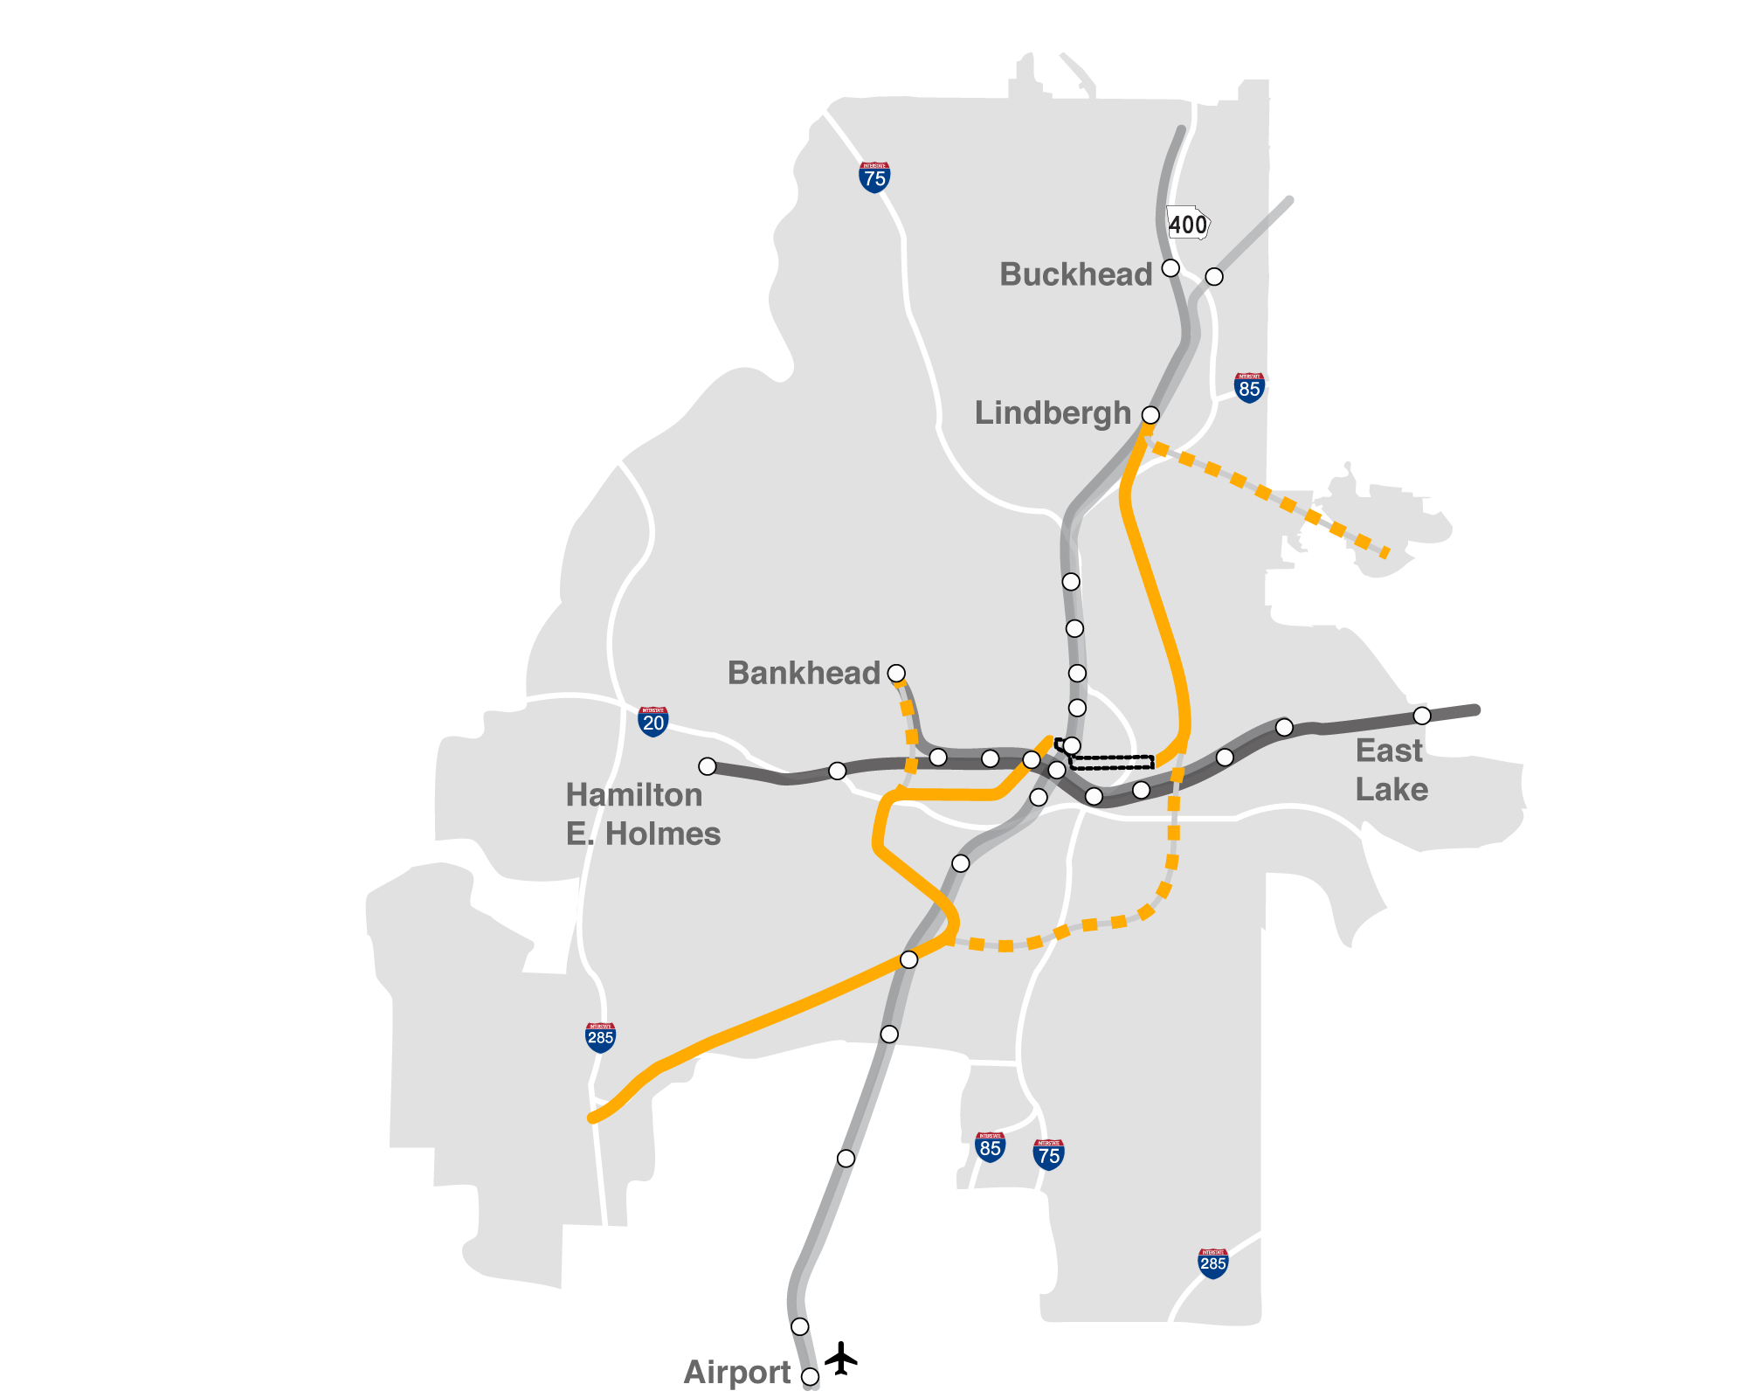
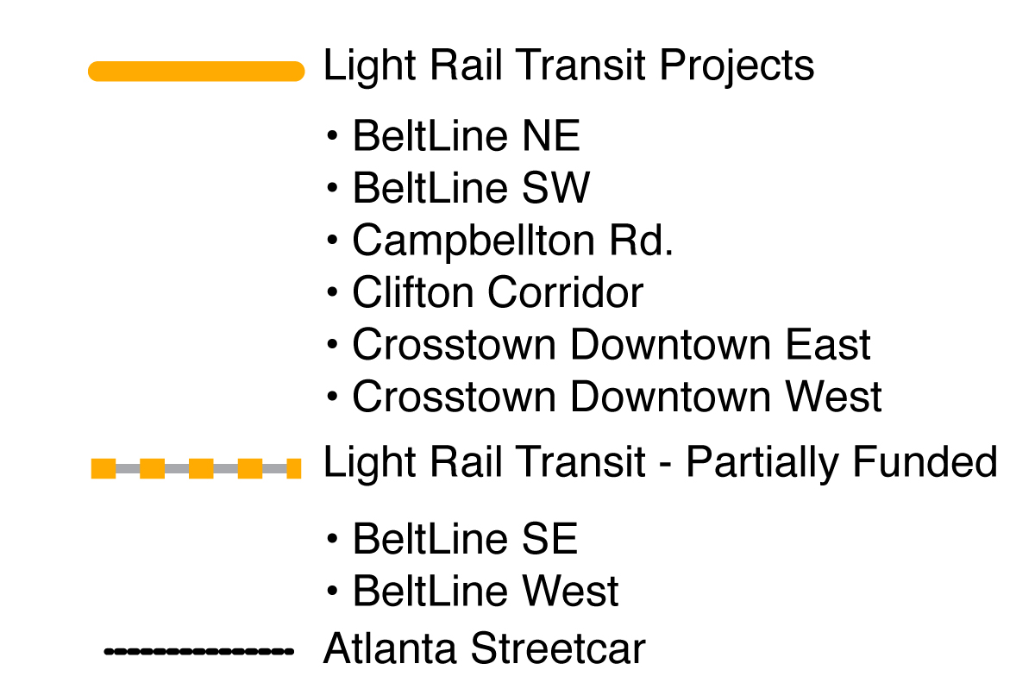
CURRENT RAIL SYSTEM + Light rail transit
Notes:
As I said earlier, light rail transit is one of the modes being implemented. This map shows the existing system, with the addition of light rail transit – 22 miles. As you can see, it’s partially funded in some corridors, which I’ll explain.
For now, know that light rail transit is coming to the BeltLine and Clifton corridors, Campbellton Road, and Crosstown East and West.
BeltLine
$570 million that builds out 61 percent of City-adopted Atlanta BeltLine Streetcar Plan
Will develop an innovative strategy to leverage additional $200 million
BeltLine Northeast: 3.1 miles – Lindbergh to Ponce City Market
BeltLine Southwest: 3.5 miles – to Oakland City Station
Clifton
$250M allocated for project, with another $100M contingent on securing full local funding
The light rail line will provide service to one of the region’s most congested areas – and biggest job centers – serving Emory University, Emory Hospital, the Centers for Disease Control and Prevention, Children’s Healthcare, and Veteran’s Administration Hospital.
Campbellton
We’re working with City leaders and other stakeholders to define land use and development strategy.
We want to ensure that transit supports a unified development plan for the full corridor.
East and West streetcar
We want to leverage the existing streetcar to expand the network.
East to Ponce City Market/NE BeltLine
West to AU Center and SW BeltLine
We want to improve streetcar operations and travel times.
Traffic signal prioritization
Dedicated lane opportunities
Queue jump opportunities

Slide 11
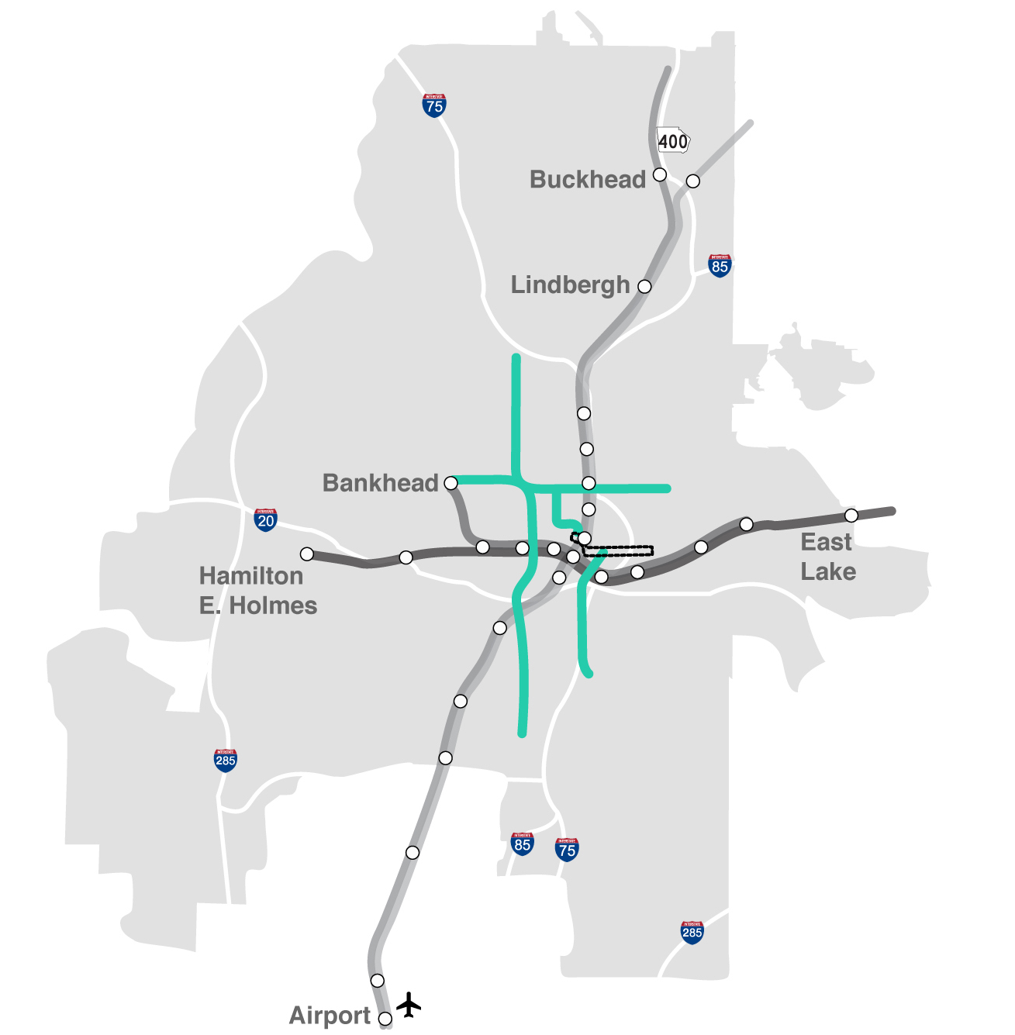
CURRENT RAIL SYSTEM + BUS RAPID transit
Notes:
This map shows the addition of Bus Rapid Transit to the existing system.
Bus rapid transit is coming to Summerhill/Capitol Avenue, North Avenue to Donald L. Hollowell Parkway and Northside Drive. We’ll be implementing 14 miles of BRT.
The goal is to initiate BRT as a system element that complements existing and future rail network. One of the foundational tenets of More MARTA Atlanta is to layer and integrate with the existing transit network. BRT helps to achieve that.

Slide 12
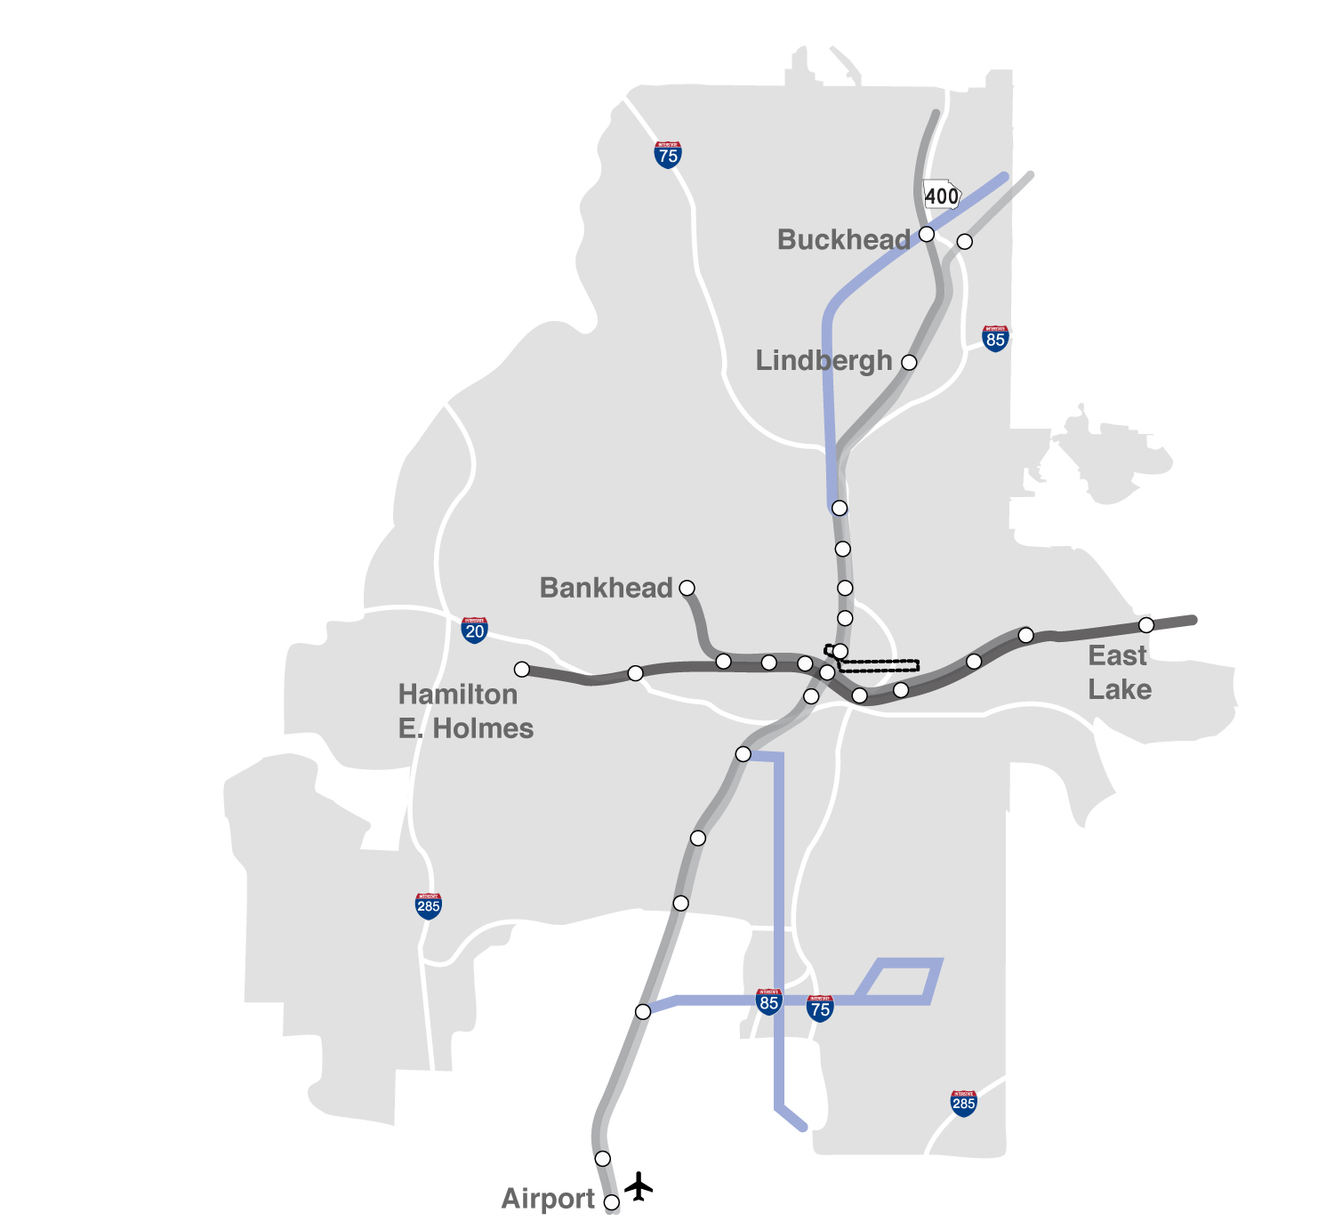
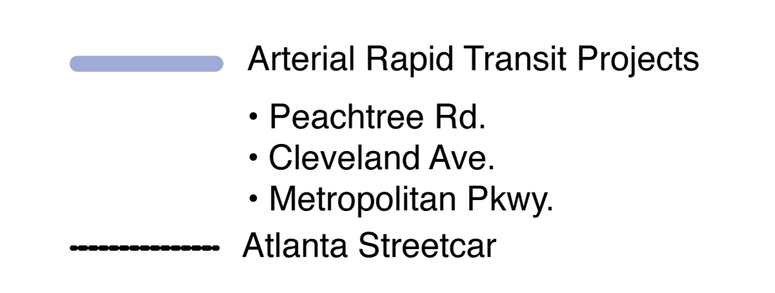
CURRENT RAIL SYSTEM + ARTERIAL RAPID transit
Notes:
This map shows the addition of arterial rapid transit to the existing system.
Arterial rapid transit is coming to Peachtree Road, Cleveland Avenue and Metropolitan Parkway. We’ll be implementing 26 miles of ART.
And as you can see from this map, it stretches from north to south.

Slide 13
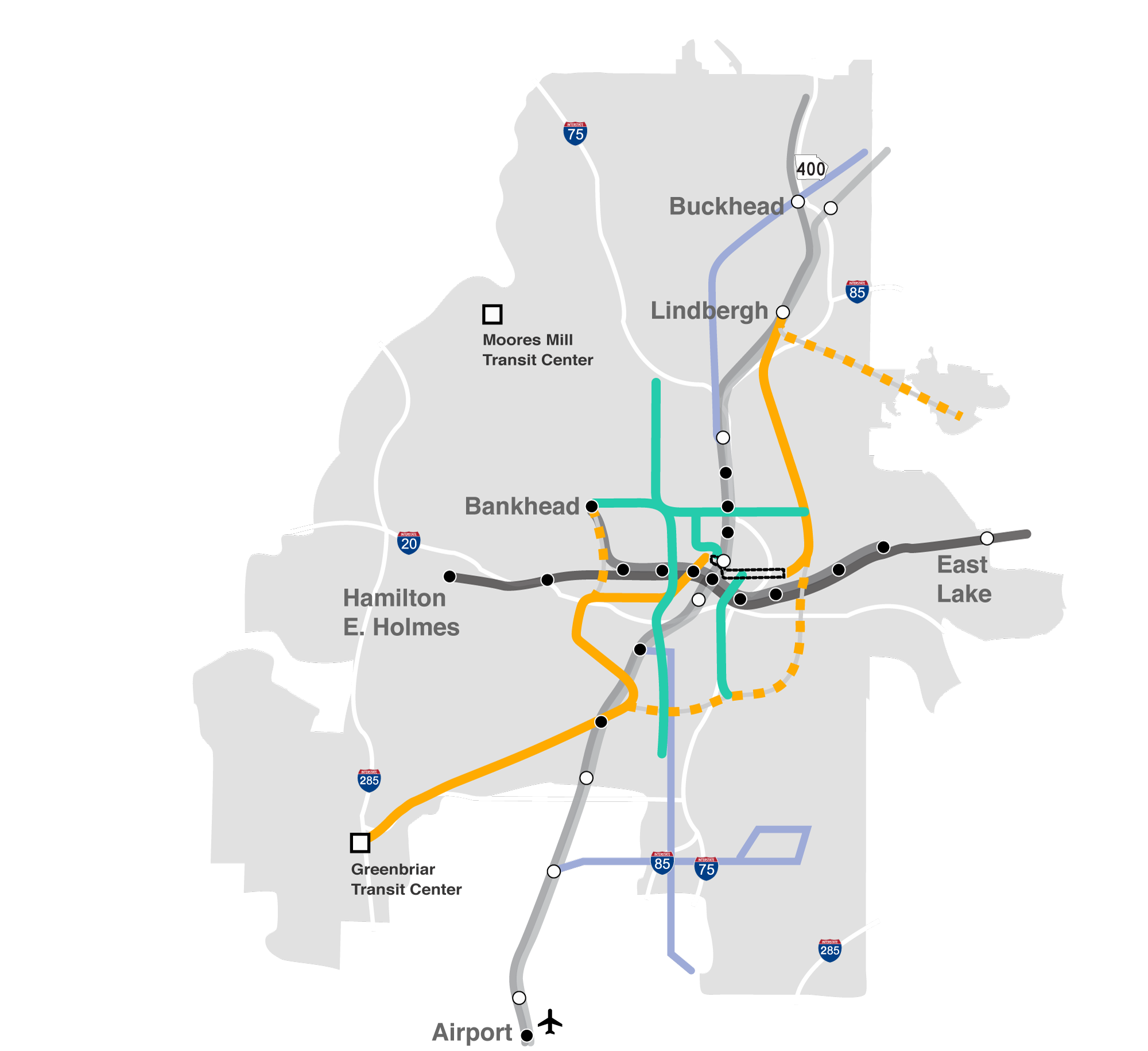
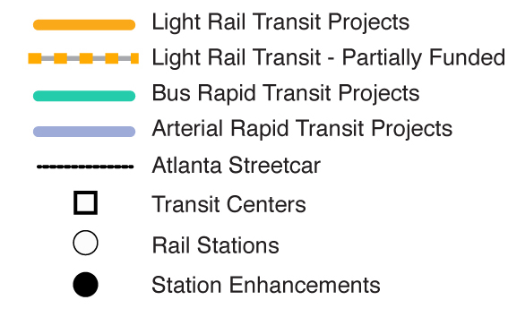
CURRENT RAIL SYSTEM
+ NEW PROGRAM
Notes:
This map shows the entire system, including all the transportation modes.
It also shows a number of station enhancements. This is a significant priority, with $200 million earmarked for transformational station enhancements. The goal is to expand and improve stations to increase ridership and accessibility. For the City of Atlanta, eight stations are the top priorities. They are Five Points, Bankhead, CNN/GWCC, Oakland City, Ashby, West End, Inman Park and Vine City.
A Five Points Station Renovation Task Force has been created. Five Points is the central station, flagship and crossroads of the MARTA system, so stakeholders want to give it appropriate focus. This makes sense. After all, the area around Five Points is seeing significant new investment and redevelopment, particularly with the Gulch project.
In addition, this map shows the new transit centers, Moores Mill and Greenbriar.

Slide 14
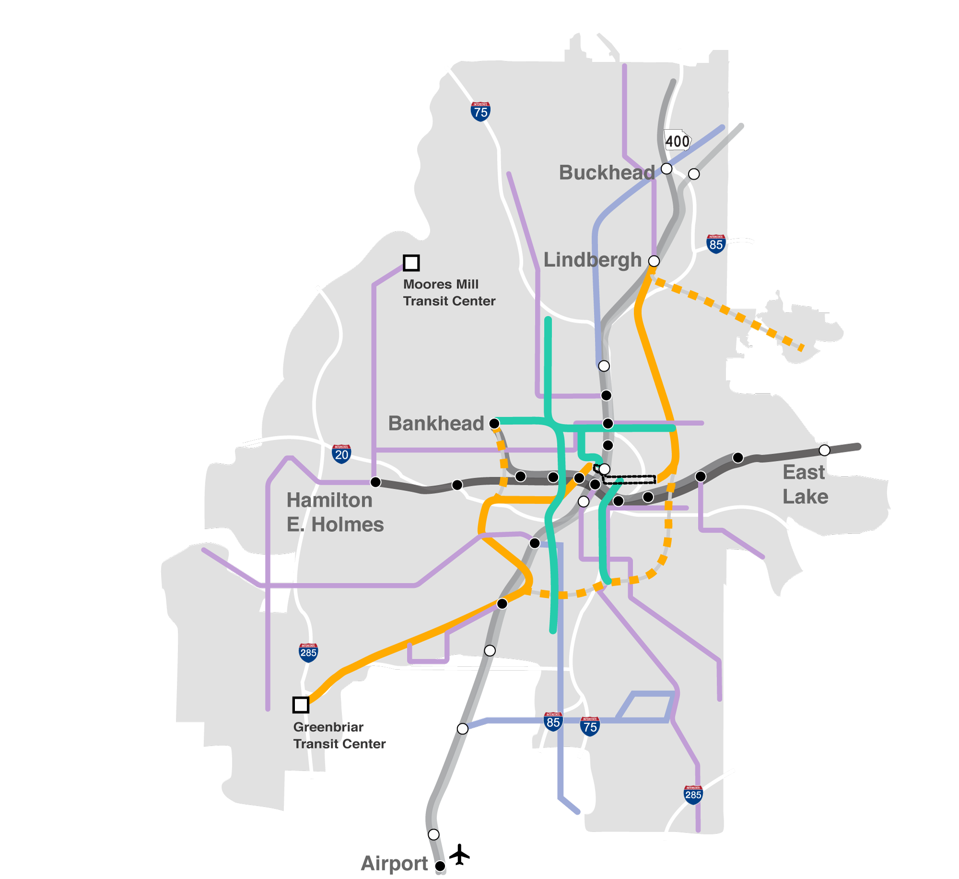
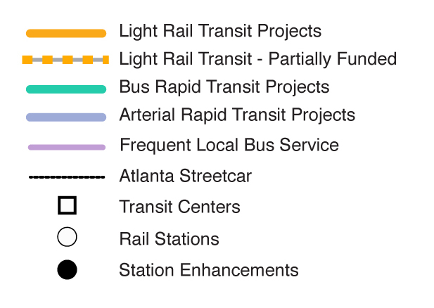
CURRENT RAIL SYSTEM
+ NEW PROGRAM
(INCLUDING FREQUENT LOCAL BUS)
Notes:
Finally, this map shows the entire system, including frequent local bus service that will meander throughout the city.
That’s a visual look at the program.
We like to think of More MARTA Atlanta as a major down payment on our future commitment to the city and to the region. Although this is an important milestone, it’s not the finish line.
Still, it’s an important step in building the Atlanta we want for decades to come.
Now let’s talk about the benefits.

Slide 15
PROGRAM Benefits
Connectivity
Accessibility
Mobility
Connects more neighborhoods, schools, stores and medical centers
Integrates with existing network and improves last-mile connectivity
Enhances safety and access to transit centers and MARTA stations
Provides greater access for large minority or low-income communities
Boosts mobility for workers to and from job centers
Increases mobility for seniors and individuals with disabilities
Notes:
During her inauguration speech, Mayor Keisha Lance Bottoms spoke of moving closer to becoming One Atlanta. Under More MARTA Atlanta, we will improve connectivity, accessibility and mobility throughout the city – ensuring we continue to grow and evolve as One Atlanta.
More MARTA Atlanta has a number of benefits. Under the program, we will connect to more neighborhoods, schools and commercial centers. We’ll enhance safety and access to transit centers and MARTA stations. We’ll improve mobility for workers to and from job centers.
In addition, More MARTA Atlanta will also provide greater access for large minority and low-income communities, and it will increase mobility for seniors and individuals with disabilities.
Specific numbers:
More MARTA Atlanta expands MARTA’s footprint to serve 126 Atlanta neighborhoods.
Atlantans will be able to use transit to access more than 350,000 jobs.
Atlanta communities with large minority or low-income populations will improve their access to transit by 61%.
MARTA will now connect riders to 77 medical facilities and 115 schools.
30 Colleges/Universities (technical/trade, fine arts, theological/seminary, medical schools, colleges, other.)
85 K-12 (private/public elementary schools/high schools)
MARTA will also give riders access to 83 grocery stores.

Slide 16
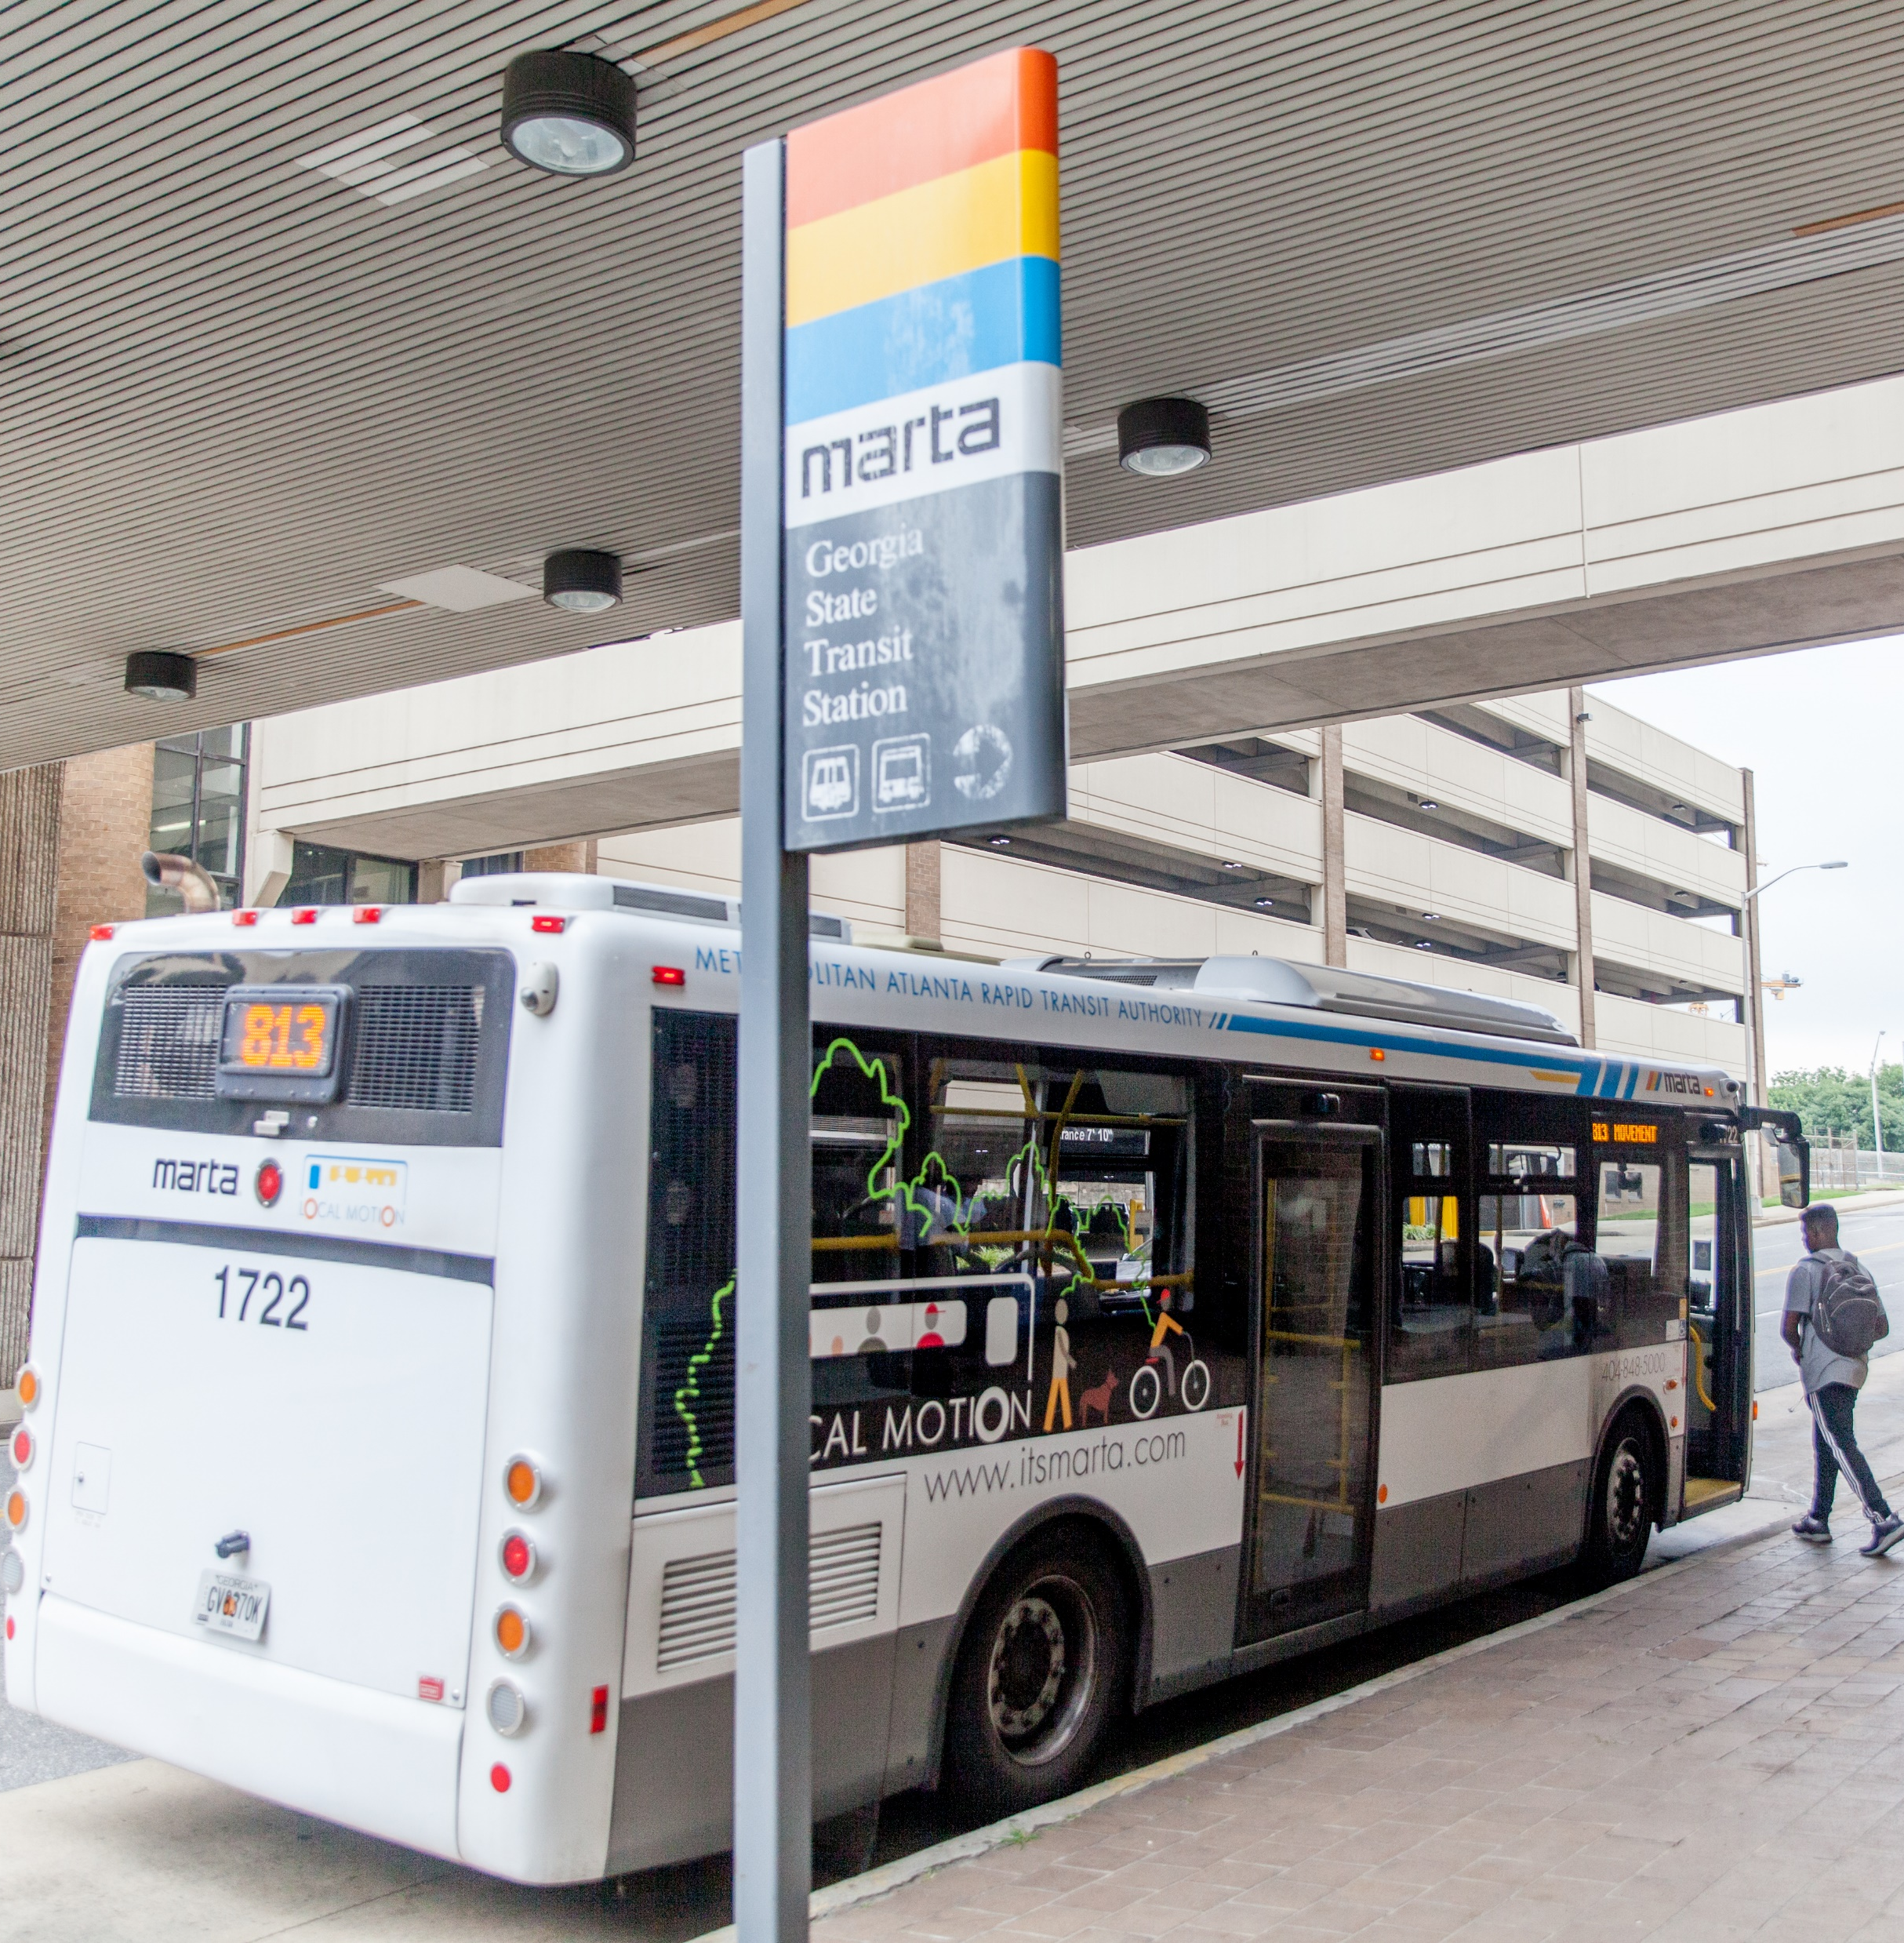
SERVICES already implemented
3 new local bus routes
1 new express bus route
10 new community circulators
3 routes timed to align with rail service
32 routes with increased service frequencies
32 routes with increased spans of service
Notes:
MARTA has already responded to what we’ve heard from voters. Beginning in February 2017, the initial phase of bus service enhancements and expansion were implemented. These were improvements made directly as a result of public input.
The improvements focused on expanded hours of service — on nights and weekends. After all, everyone doesn’t work 9 to 5, Monday through Friday. Service frequency was also cut down from a wait of an hour or more to 30-45 minutes.
Improving headways and frequencies and adding service has led to bus ridership within city limits that is more resilient and higher than service elsewhere in the system. This has made transit more convenient in the city and added jobs. All service changes and additions were made by MARTA in coordination with City leaders and engagement with the public and stakeholders.
3 local bus routes
14 14th Street / Blandtown
40 Peachtree Street / Downtown
94 Northside Drive
1 express bus route
295 Metropolitan Campus Express
10 circulator routes:
809 Monroe Drive / Boulevard
813 Atlanta Student Movement Boulevard
816 North Highland Avenue
832 Grant Park
850 Carroll Heights / Fairburn Heights
853 Collier Heights
856 Baker Hills / Wilson Mill Meadows
865 Boulder Park Drive
867 Peyton Forest / Dixie Hills
899 Old Fourth Ward

Slide 17
IMPLEMENTATION TIMELINES: KICK-OFF TO OPERATIONS*
Up to 4 years Arterial rapid transit (ART)
Up to 5 years Station enhancements
Up to 6 years Transit centers
Up to 7 years Bus rapid transit (BRT)
Up to 10 years Light rail transit (LRT)
*These benchmarks vary by project and are subject to change. Includes planning, environmental, design, construction and startup activities.
Notes:
The More MARTA Atlanta program is comprised of short- and long-term projects that will be executed in various phases over the course of the projected 40-year timeframe.
We want to be conservative in terms of our expectations for project durations. While some projects can be completed relatively quickly, other projects will take longer (i.e. Clifton).
Having said that, we do believe there are some potential early projects, including the following:
Station enhancements: Five Points, Garnett and Bankhead
Summerhill: A $12 million TIGER grant has already been awarded
East and West Streetcar extensions, which provide …
Opportunity to get to the BeltLine
Opportunity to improve existing Streetcar operations
Campbellton: Accelerating under the Renew Atlanta project
Greenbriar Transit Center: A LCI effort underway
There are a number of evaluation factors involved, though. They include:
Project readiness
FTA readiness
Geographic distribution
Socioeconomic factors
Community support
Political feasibility
Network connectivity

Slide 18
MAJOR PROJECTS: CURRENT DEVELOPMENT STAGE
BeltLine Corridor:
We are here
Planning
Environmental Review
Final Design
Construction
Operations
Campbellton Road:
We are here
Planning
Environmental Review
Final Design
Construction
Operations
Clifton Corridor:
We are here
Planning
Environmental Review
Final Design
Construction
Operations
Notes:
Many of these projects will move through various development stages. For our purposes, there are five primary stages: planning/NEPA, environmental review, engineering/final design, construction and testing/operations.
As you’ll notice, three of the largest projects are in the planning or environmental review phases. BeltLine and Clifton are slightly ahead.
Just so you can get your head around how long it takes projects to move through these phases, we’ve made a few assumptions.
For LRT
Planning/NEPA: 1-2 years
Environmental review: 1-2 years
Engineering/final design: 2 years
Construction: 4 years
Operations/testing: 1 year
For BRT
Planning/NEPA: 1-2 years
Environmental review: 1-2 years
Construction: 3 years
Operations/testing: 1 year

Slide 19
Regionwide transit EXPANSION INITIATIVES
Clayton
Gwinnett
Fulton
DeKalb
1-cent sales tax passed in 2014
Includes bus service/facilities and high-capacity transit
Referendum goes to voters in March 2019
If approved, 1-cent sales tax will fund heavy rail/bus service
Referendum possible
Transit Master Plan completed in 2018
Focus on bus rapid transit (i.e. GA 400)
Transit Master Plan underway; completion expected in 2019
Evaluating local transit; high-capacity corridors
Notes:
More MARTA Atlanta is a piece of a larger transit puzzle. We’re seeing expansion, and potential expansion, in several counties.
Clayton County voters, for instance, passed a 1-cent tax in 2014. It will generate $48 million a year for bus service and facilities as well as high-capacity transit. To date, we have 9 existing bus routes, 16,000 riders per day (up 17%), and we’ve initiated a facility site selection study
In Gwinnett County, a referendum will go before voters in March. If approved, the 1-cent sales tax will fund heavy rail and bus service. Today, Gwinnett already has 5 express routes and 7 local routes. Future plans call for many more local and express routes, as well as BRT and rail corridors.
In Fulton County, leaders are preparing for a potential referendum on transit. The focus in Fulton is on bus rapid transit for Georgia 400, Holcomb Bridge Road, Roosevelt Highway and South Fulton Parkway. The county has already completed a Transit Master Plan.
In DeKalb County, a Transit Master Plan is underway, with a scheduled completion in June 2019. The county is evaluating local transit and major high-capacity corridors.

Slide 20
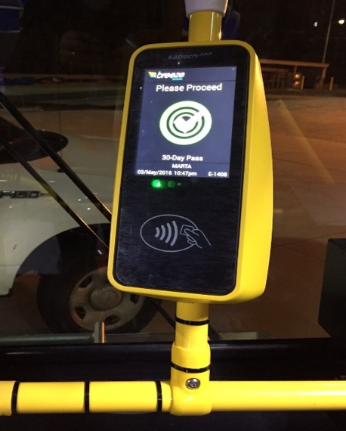
CURRENT INITIATIVES: Major system upgrades
Railcars
$1 billion investment to replace entire fleet, some dating to 1979, over next decade with modern cars
Bus shelters
Agency adding shelters with seating at bus stops
Up to 1,000 new shelters expected in next five years
System enhancements
Tunnel ventilation system
Escalator/elevator revamp
Public address system
Clean diesel/CNG buses
Technology
Free Wi-Fi on all buses and trains; expansion underway to all stations
Mobile payment app
Notes:
MARTA has a lot of exciting initiatives underway beyond transit expansion. Here’s a closer look at a few of the upgrades in store for our riders. These enhancements fall under MARTA’s capital program:
Railcars
MARTA is looking to replace its entire fleet of railcars, including some that date to 1979, an effort that will cost $700 million to $1 billion. In the coming years, MARTA will add new, modern cars, which will be easier to load and unload and more comfortable for passengers. The new fleet may include more charging stations, live graphic displays and maps.
BUS Shelters
MARTA is adding many new shelters, along with seating and digital information at many bus stops within the City of Atlanta.
System enhancements
We’re performing some major system upgrades:
Tunnel ventilation system
Tunnel ventilation is a critical infrastructure component in all subway transit environments, and MARTA has identified the renovation and renewal of its aging system as important to maintain optimal functionality and state of good repair. MARTA’s TVs includes a network of fans and dampers that effectively control and direct air flow during normal rail operations and in emergency situations.
Elevators/escalators
In 2017, MARTA launched an ongoing initiative to overhaul our vertical transportation system, including our elevators and escalators. We have 116 escalators and 111 elevators to modernize under our 10-year plan. The entire MARTA portfolio of vertical transportation equipment includes a total of 150 escalators and 115 elevators. A number of elevators and escalators have been completed or are in progress.
Public address system
MARTA is installing an audible delivery system in 38 stations. Benefits include compliance with ADA requirements (i.e. synchronized audio and visual messaging); real-time bus and train information; and safety and security alerts communicated systemwide.
Clean diesel and compressed natural gas (CNG) buses
New Gillig clean diesel and compressed natural gas buses will replace older buses. The 30-foot buses will be used on community circulator routes.
TECHNOLOGY
Wi-Fi
MARTA now has free Wi-Fi Lite on all buses and trains. We are expanding our Wi-Fi and cellular services to our stations. Currently, only Five Points, Peachtree Center and Dome Stations have Wi-Fi.
Mobile payment app
MARTA is testing a smartphone app that would replace Breeze cards and enable riders to buy train and bus passes and scan through gates all on the phone. This was first reported in 2016.

Slide 21
NEXT STEPS ON MORE MARTA ATLANTA
Programming of projects
Schedule development
Financial plan development
Continued public outreach and education activities
Process for intergovernmental cooperation on projects that are in both City of Atlanta and DeKalb County
Regular reporting to MARTA Board and Atlanta City Council
Notes:
We talked briefly about next steps, but let me provide some more details:
First, let’s talk about programming of projects.
Under schedule development, the next steps under More MARTA Atlanta include examining the 16 approved projects and figuring out how and when to do them – in what order and sequence over the next 40 years. In early 2019, the More MARTA Atlanta team is expected to develop the best order of projects. Once that is achieved, the team will present a plan to the Mayor and Atlanta City Council. Then in early June, we expect Board action.
Under financial plan development, the next steps include developing a more sophisticated cash flow model (with federal funding assumptions) and creating preliminary project sequencing.
Next steps also include public outreach and education. We’re not taking our foot off the gas to ensure the public knows what’s happening. In addition to our four community meetings (Southwest, Southeast, Northwest, Northeast), we’re conducting sessions with stakeholders and partners as well as the business community in the months ahead.
In addition, we will seek intergovernmental cooperation, particularly with DeKalb County.
And as we’ve done for the past two years, we will report our progress regularly to the MARTA board and Atlanta City Council – as well as the general public – to ensure full transparency.

Slide 22
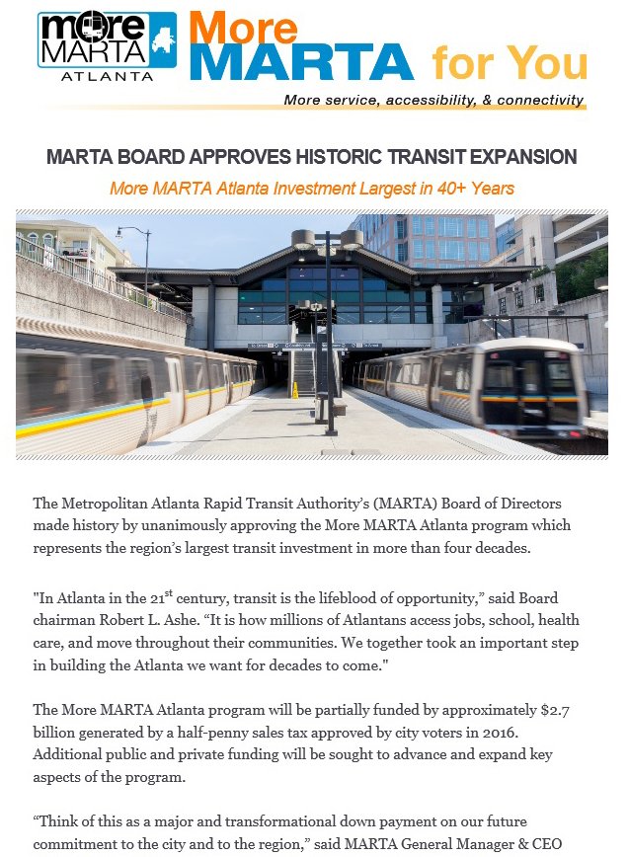
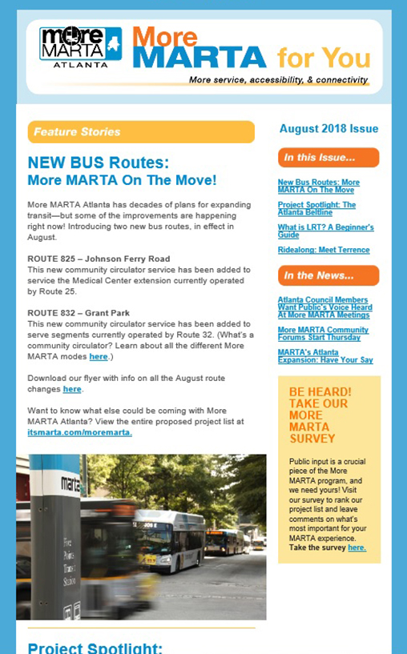
Stay Connected
Follow us on social media:
@MARTASERVICE
/MARTAtransit
@marta_explorer
Visit www.itsmarta.com/moremarta ...
To learn more about More MARTA Atlanta
To subscribe to our More MARTA for You newsletter
To contact us via email or phone
Notes:
We want you to stay connected. Follow us on social media and email or call us if you have questions.
Also, you’ll find a treasure trove of information at our More MARTA website at www.itsmarta.com/moremarta. What you’ll find online:
Benefits of public transit
Guiding Principles: The foundational tenets of the program
Survey results: 7,024 surveys completed from May-August 2018
More MARTA Atlanta fact sheets
Technical analysis
Maps
Types of transit services and vehicles
Also, we have a More MARTA for You newsletter
Join our mailing list and view current and past issues
To reach us, email: moremarta_atlanta@itsmarta.com or call 404-848-4135

Slide 23
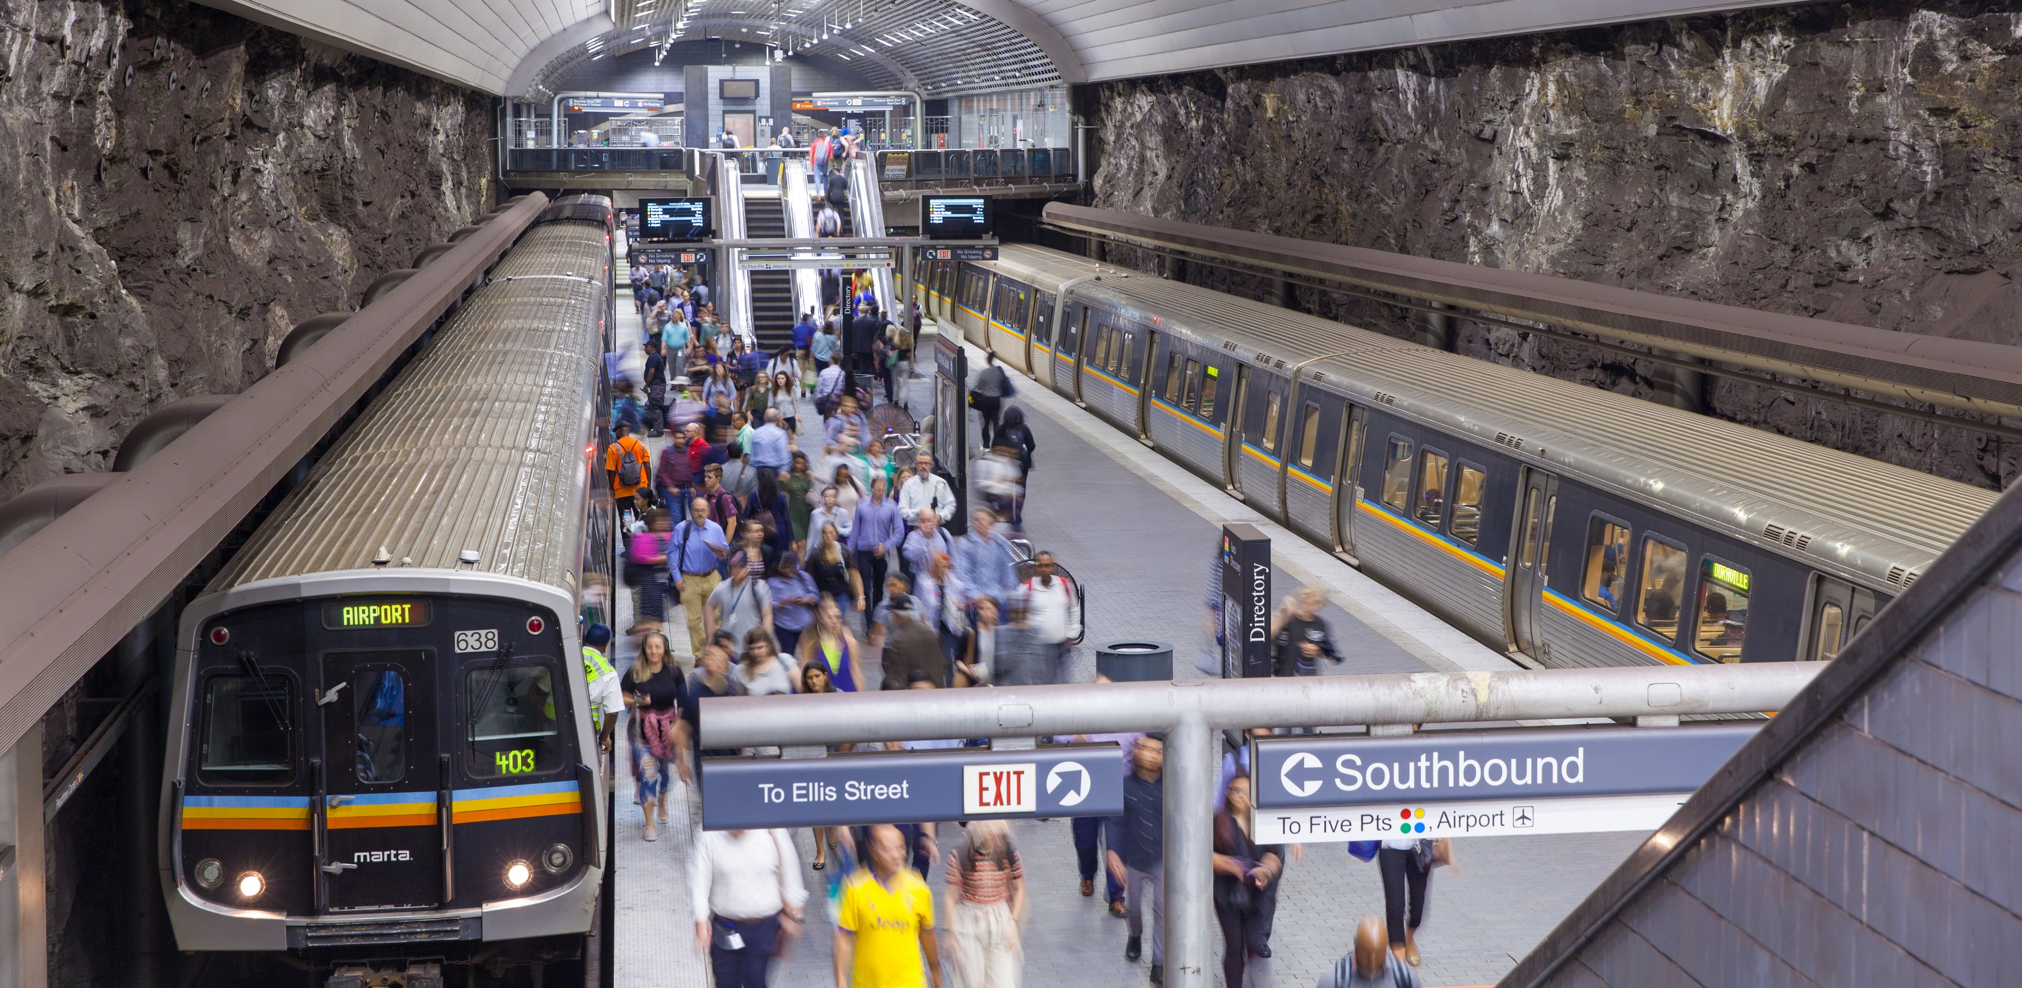
Thank you!
COMMUNITY MEETING – SOUTHEAST
Ehren Bingaman, More MARTA Atlanta | Nov. 27, 2018
Notes:
Thank you for taking time out of your schedules to join us for this community meeting. I hope you found this information useful.
Keep in mind that as More MARTA Atlanta moves forward, we’ll be disseminating more information about specific projects and their status.
Thanks again for your time and attention.

